Slide 1


Slide 2
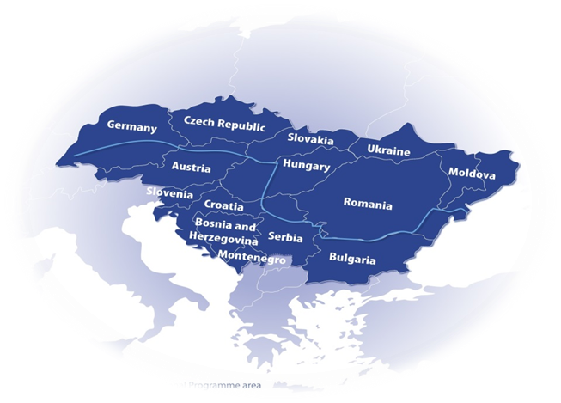
Programme area

Slide 3
Transnational Cooperation
transnational dimension:
project topic, addressed challenge and contributing project activities have transnational, broader territorial and/or thematic character and relevance (not limited to a few, 3-4 countries)
transnational impact:
based on the planned activities and outputs the impact of the project can be considered relevant on transnational scale and not only on local level in different parts of the region
A collection of different local actions of PPs under one „umbrella”, or cross-border cooperation is not transnational

Slide 4
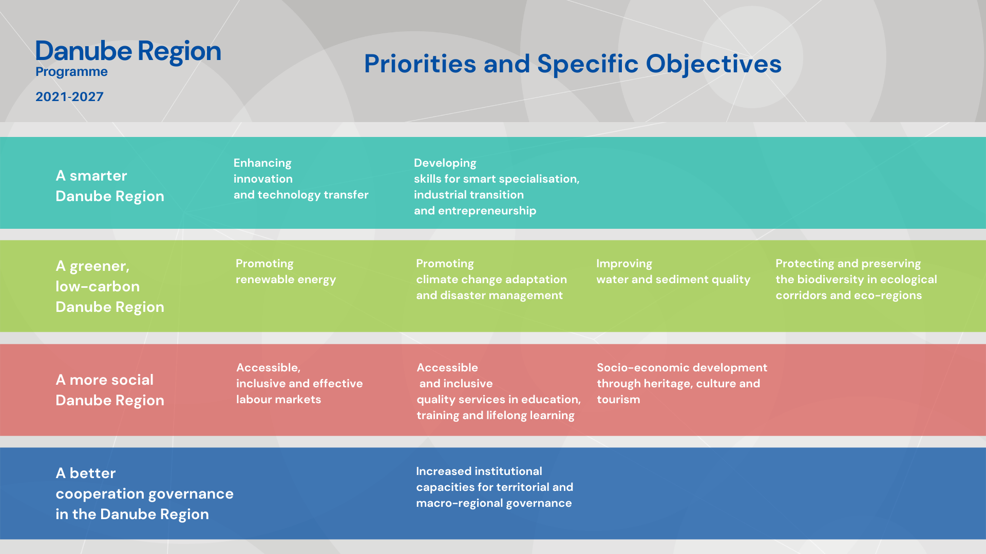

Slide 5
SO 2.2 - Promoting climate change adaptation capacities in the Danube Region and disaster management on transnational level in relation to environmental risks, taking into account ecosystem-based approaches
SO 2.3 - Sustainable, integrated, transnational water and sediment management in the Danube River Basin ensuring good quality and quantity of waters and sediment balance

Slide 6
SO 2.2 – needs and challenges
Danube Region exposed to climate change
  increasing annual mean temperatures,
  wet regions becoming wetter, dry regions drier
  increasing intensity and frequency of heat waves, dry periods, heavy rainfalls
increasing frequency & severity of environmental disasters
  floods, droughts, forest fires
impacts on ecosystem, economic sectors, human life on transboundary scale
impacts of accidental pollutions along major rivers need coordinated transnational emergency response

Slide 7
SO 2.2 - Focus
strengthening cooperation of key actors of transnational area
Danube Region scale CC forecasting & vulnerability assessment
harmonised, coordinated disaster prevention, preparedness, response
preparedness and adaptive capacity to cope with impacts of CC
  climate services to foster resilience
flood & accidental pollution management actions shall target main transboundary river(-basin)s

Slide 8
SO 2.2 – What is supported
improve policies and institutional capacities (e.g. integrated strategies, action plans, policy & sectoral dialogs, trainings)
harmonising management processes (e.g. management, contingency plans)
Elaborating, pilot testing joint solutions (e.g. monitoring, forecasting tools, data bases)
reasonable mix of activities with clear thematic focus
territorially integrated, cross-sectoral approaches

Slide 9
SO 2.2 – What is supported
harmonised CC modelling, forecasting and vulnerability assessment on DRB scale
  applied at policy, operational level
CC adaptation
  integration of research results
  improving skills and competences for policy makers and stakeholders
coordinated flood risks / drought prevention
  option of nature-based solutions
combat flood, drought, accidental pollution of transboundary rivers and CC related other disasters
  Harmonised planning, monitoring, alert systems, inventories
  improving operational cooperation, capacities of emergency response bodies
Regional level CC & environmental risks related disaster preparedness activities

Slide 10
SO 2.2 – What is not supported
if need for cooperation on transnational level not demonstrated
flood / accidental pollution management not focusing on main transboundary river(-basin)s
pre-dominant focus on infrastructure
pre-dominant focus on technical solution development without application by target users
pre-dominant focus on research /data collection without translating into applied solutions / policy strategies, plans
water scarcity related CC adaptation - low water periods affecting balanced use and quality of water (addressed in SO2.3)
biodiversity related CC adaptation - on habitats, protected areas and forestry (addressed in SO2.4)

Slide 11
SO 2.2 – state of play after 1st call
4 projects selected
SAFETY4TMF - transnational accidental pollution risks of Tailings Management Facilities in DRB
Be Ready – urban heat islands
Sponge City - (flash-)floods and water scarcity in urban areas
RESTORIVER - NBSs in urban/peri-urban riverside areas for CC adaptation
New proposals to focus on topics not addressed by these projects!
Projects with broader territorial scope in which transnational level harmonisation, coordination of monitoring, preparedness, or reaction is necessary in connection to relevant climate change induced environmental risks

Slide 12
SO 2.2 – typical mistakes in 1st call applications
out of thematic scope - (e.g. industrial contamination without transnational river; post-disaster renovation; disaster management in case of electric vehicle accident)
technology development in focus instead of specific territorial need
limited partnership and / or territorial scope
selecting wrong SO (instead of 2.3, or 2.4)
weaknesses in project intervention logic
missing links to relevant EUSDR PAs

Slide 13
SO 2.3 – needs and challenges
Danube Region covers water system of the Danube River Basin
focus is on water quantity, quality and sediment balance of transboundary river(basin)s, surface and underground water bodies
pressures:
  contamination and water pollution
  increasing water use, decreasing ground water levels, shrinking supplies
  increasing periods of low water in transnational river systems
  sediment balance alterations
impacts beyond country borders need for cooperation of upstream & downstream countries

Slide 14
SO 2.3 - Focus
prevention and mitigation of water pollution / restoration of good quality of transnational water bodies
harmonising management practises between key sectors to improve quality, quantity of water and sediment
transnational coordination of water supply management, especially in relation to basin-wide importance of groundwater bodies

Slide 15
SO 2.3 – What is supported
improve policies and institutional capacities (e.g. integrated strategies, action plans, policy & sectoral dialogs, trainings)
harmonising management processes (e.g. management plans)
elaborating, pilot testing joint solutions (e.g. monitoring, forecasting tools, data bases)
reasonable mix of activities with clear thematic focus
territorially integrated, cross-sectoral approaches
taking into consideration potential negative effects of CC

Slide 16
SO 2.3 – What is supported
harmonised data availability, monitoring, modelling systems for transnational water management
capacities to prevent, mitigate water pollution / restore good quality of water
improving sediment balance and related morphodynamics
potentials of floodplain reconnection to improve water quality
monitoring, modelling of transboundary groundwater systems
measures ensuring balanced use of water, regarding CC impacts
measures in connection to CC induced low water periods on transnational rivers of DRB (sediment, navigation, HPP)

Slide 17
SO 2.3 – What is not supported
if need for cooperation on transnational level not demonstrated
not focusing on main transboundary river(-basin)s of DRB
pre-dominant focus on infrastructure
pre-dominant focus on technical solution development without application by target users
pre-dominant focus on research /data collection without translating into applied solutions / policy strategies, plans
emergency response to accidental pollution of main transboundary river(-basin)s (addressed in SO2.2)
potentials of floodplain restoration in case their focus is on flood protection (addressed in SO2.2), or focus on ecological corridors and biodiversity (addressed in SO2.4)

Slide 18
SO 2.3 – state of play after 1st call
5 projects selected
AQUATIC PLASTIC – macro-plastic in transboundary rivers
Danube Water Balance – harmonised DRB water balance modelling system
DanubeSediment_Q2 - DRB sediment balance and quality management
MicroDrink - micro-plastics in drinking water resources
Tethys - Hazardous Substances water pollution in DRB
New proposals to focus on topics not addressed by these projects!

Slide 19
SO 2.3 – typical mistakes in 1st call applications
out of thematic scope - (utilisation of Selenium residues from industry)
limited partnership and / or territorial scope
weaknesses in project intervention logic
missing links to relevant EUSDR PAs

Slide 20
Partnership
minimum requirement: 3 financing partners from 3 DRP countries
Competitive projects to be based on much broader partnerships!!!
  number of countries to be involved ensuring broad territorial impact in DR
  number of PPs ensuring thematic and territorial relevance and competence in a coherent mix and balanced way
integration of non-EU countries!!!
„INTERREG funds” = equal participation of EU and non-EU partners
  no differentiation of PPs by ERDF, IPA and NDICI funds
  Lead partner can be from any DRP country (in 2nd call not from UA)

Slide 21
Budget
„Interreg funds” – bringing together ERDF, IPA and NDICI funds
maximum EU (Interreg) contribution - 80%
2nd call allocation:
Priority 2 | Interreg funds per Priority in EUR | Indicative allocation per SO in EUR
SO 2.1 | closed
SO 2.2 | 15 339 422,00 | 5 960 525,00
SO 2.3 |  | 4 524 737,00
SO 2.4 |  | 4 854 160,00

Slide 22
DRP 2nd Call for Proposals
Call opening
  2 November 2023
  29 March 2024
Online application in DRP Jems (Joint Electronic Monitoring System – accessible on programme website)
Project duration: max. 36 months
Estimated project start: early 2025

Slide 23
Resources & tools
DRP INTERREG Programme - website
    How to apply (https://www.interreg-danube.eu/dtp-archive/about-dtp/new-funding-2021-2027/how-to-apply)
    2nd call (https://www.interreg-danube.eu/dtp-archive/about-dtp/new-funding-2021-2027/how-to-apply/second-call)
      Lead applicant and thematic webinars
      Applicants Package
DRP matchmaking platform for partner search (available soon)
Network of National Contact Points
JS: ad-hoc advice on technical/formal issues & one bilateral consultation
EUSDR PAs

Slide 24
Contact
Gusztáv Csomor – Senior Project Officer
gusztav.csomor@interreg-danube.eu
https://www.interreg-danube.eu/about-dtp/new-funding-2021-2027

