Slide 1

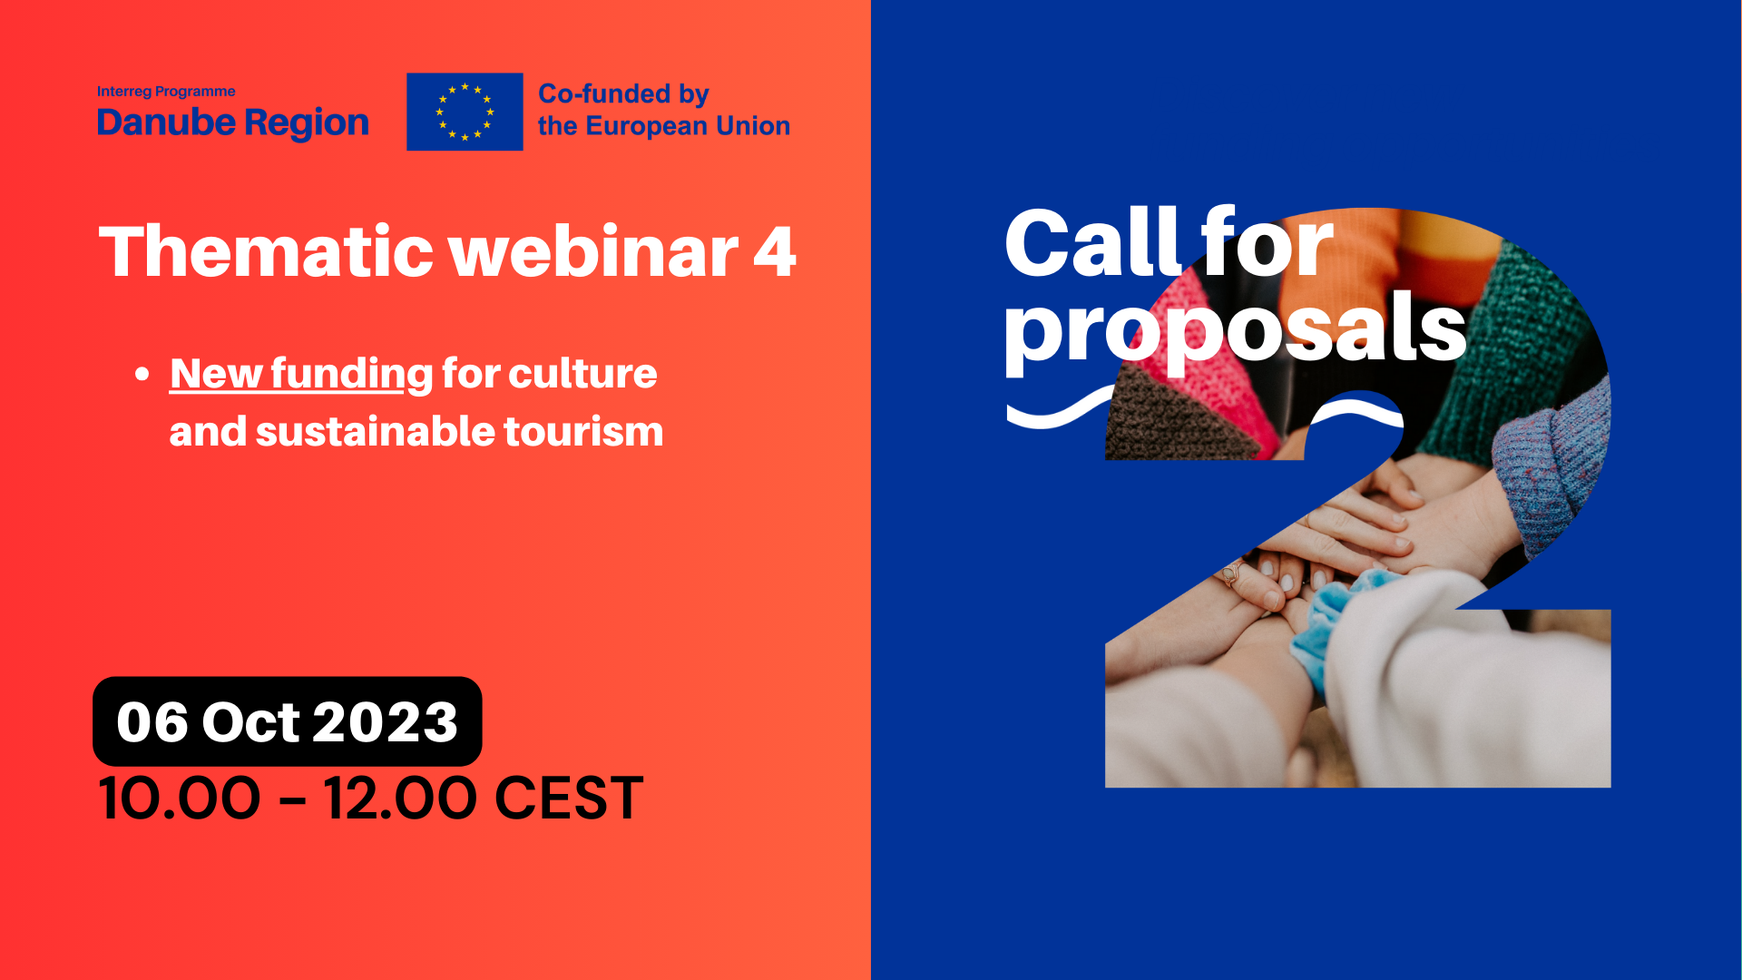

Thematic webinar
SO 3.3.
Culture and sustainable tourism
Liholot Natalia
Project Officer
06 October, 2023

Slide 2


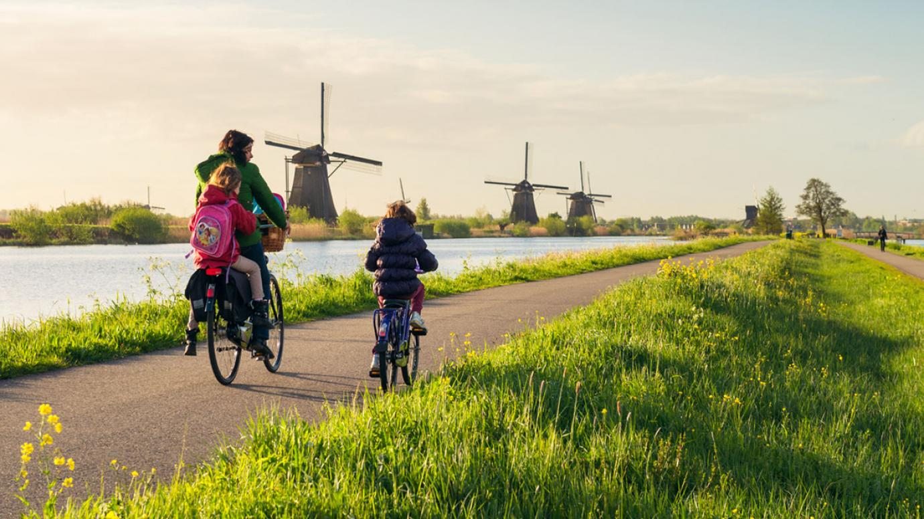
SO 3.3. Thematic Webinar
Enhancing the role of culture and sustainable tourism in economic development, social inclusion and social innovation
State of play
Opportunities and expectations from the 2021-2027 perspective
Transnational cooperation
Priority 3
Focuses of SO 3.3
Needs and challenges
Types of possible actions
What we do not finance
Important documents
Connection with EUSDR
Importance of synergies and capitalization
Q & A

Slide 3

State of play (1)
The first Call for Proposals finished on June 16, 2023
89 out of 90 submitted!!!!
17 applications submitted within SO 3.3.
Decision of the MC on selected proposals – October 2023.

Slide 4

State of play (2)
The 2nd Call - one-step procedure.
Only electronic submission through Jems.
There are no budget restrictions for the project.
One organization can be a partner in more than one project.
Opening Date of the Second Call: End of October 2023.
Call Deadline: End of March 2024.
The estimated starting date of the projects is January/February 2025.
The duration of projects must not exceed 36 months.
The DRP covers the entire territory of Ukraine (UA) but the UA partners can’t be the LP in the 2nd call.
Min. 3 partners are needed (at least one from EU Member states)

Slide 5


Oportunities and expectations from the 2021-2027 perspective
DRP embraced and pooled the EU 3 funds (IPA, ERDF, NDICI) together into “Interreg Fund”.
Programme budget (Interreg Fund) - 215 047 857,00 EUR/224,603,752.00 EUR.
- Integration of non-EU countries is of utmost importance.
- The maximum EU contribution to the projects is a co-financing rate of 80%. No pre-financing.

Slide 6
Transnational Cooperation
The projects to be submitted to the DRP should stem from a common need and challenge, covering the wider territory of the Danube region and not limited to a few, 3-4 countries.
The project activity must have a sufficient transnational dimension, territorial and/or thematic nature and relevance, as well as the impact of the project, its results must be relevant on a transnational scale, and not only at the local level or in different parts of the region.
Transnational projects should not be confused with cross-border projects.
Applicants must demonstrate that the stated need/challenge is best addressed at the transnational level rather than at the local/regional/cross-border levels.

Slide 7

Priority 3 – A more social Danube Region
Specific objective 3.1 - Accessible, inclusive and effective labour markets.
Specific objective 3.2 - Accessible and inclusive quality services in education, training and lifelong learning.
Specific objective 3.3 - Enhancing the role of culture and sustainable tourism in economic development, social inclusion and social innovation
!!! Read factsheet: https://www.interreg-danube.eu/about-dtp/priorities-objectives-2021-2027/priority-3-more-social-danube-region

Slide 8

Focuses of SO 3.3 Enhancing the role of culture and sustainable tourism in economic development, social inclusion and social innovation
Focus 1
Valorisation of local cultural and natural heritage for the development of sustainable tourism products and tourism services in order to increase regional added value and employment.
Focus 2
Improvement of accessibility of cultural and natural heritage for all, amongst others
youth and vulnerable groups in order to promote social inclusion.
Focus 3
Promoting community led natural and cultural heritage management and associated nature based and cultural tourism in rural areas and small cities.

Slide 9

Needs and challenges
Missing inclusive strategic planning to guide and coordinate the valorisation in many of the remote, rural areas and smaller settlements which are confronted with a lack of in depth recognition of the heritage and cultural assets value and the potential that they have.
Insufficient efforts for making the assets and initiatives available to all, even if this can be a challenging process for minorities and rural and remote areas.
Cooperation of stakeholder institutions on heritage valorisation.
Historically limited access to cultural and heritage assets and initiatives, both in a geographical and a socially inclusive sense in the Danube region.
Coordinated preservation and
(destination and heritage) management of heritage sites and cultural landscapes.
Fostering the integrated social, economic and environmental local development, cultural heritage and security, including for rural and remote areas also through community-led local development.

Slide 10
Types of possible actions SO 3.3.(1)
Capacity building in social innovation to better support valorisation of joint cultural and natural heritage, in particular for tourism and their heritage management schemes (study, collection, preservation, digitalization, exhibition and re-interpretation of joint tangible and intangible elements).
Valorisation of joint natural and cultural heritage and cultural activities through the elaboration of new or improved thematic initiatives for example cultural, hiking, cycling or other thematic routes and initiatives across the macro-region with a special focus on rural or less visited areas.
Promote sustainable and slow tourism concepts, planning methodologies, model regions, and management tools in the Danube Region, in regions of mass tourism as well as in regions having a weakly developed tourism sector, including those at risk due to climate change. Actions should promote and safeguard employability and employment possibilities to vulnerable groups of host communities, and capitalise on EUSDR projects in the interconnected areas of culture, nature and tourism.

Slide 11
Types of possible actions SO 3.3.(2)
Capacity building and development of innovative models for community based tourism to better secure the engagement of host communities by involving them in the planning, management and implementation tourism development in their respective regions.
Improving the accessibility of tourism and culture infrastructure, products and services for vulnerable groups, such as minorities, people with disabilities, the elderly and youth in regions with low levels of accessibility and high levels of vulnerable groups. Innovative approaches involving digitization, digitalization, artificial intelligence and the internet of things are encouraged.
Promoting quality products, services and transnational infrastructure in the tourism and culture sector to support the social inclusion of disadvantaged people via new employment forms and job opportunities. This especially in relation to regions with a high share of ethnic minorities and areas with a large share of population at risk of poverty including the youth, elderly or disabled.

Slide 12

Target Groups/Potential Partners
Local, regional and national public authorities and organisations established and managed by public authorities responsible for environmental, tourist and cultural issues, sectoral agencies, regional development agencies, social enterprises, employment organisations, tourist operators, tourist information centres (points), regional tourism boards/ destination management organisations and museums, research and development institutions, universities with research facilities, business support organisation (e.g. chamber of commerce, business innovations centres), higher education, education/training centre and school, NGOs, private enterprises including SME.

Slide 13

What we do not finance
• Projects without clear focus.
The projects without clear territorial scenario.
Projects with pre-dominant focus on research and data collection activities without translating their outcomes into applied solutions and, or policy strategies, planning.
Projects without the expected social consideration.
Projects with pre-dominant focus on infrastructure.
Training which is not part of piloting e. g. expanding existing training.

Slide 14
Important documents
The application package and all relevant information about the 2nd CfP will be available from the end of October 2023 on the program website: http://www.interregdanube.eu.
The program provides supporting tools at the application stage (e.g. individual consultations) and events (e.g. thematic webinars, info days) to facilitate project generation and support applicants in the project development process.
For general advice on the program and compliance requirements and national regulations, please contact your national contact point.
For advice on the thematic focus of the project, please contact the program
danube@interreg-danube.eu

Slide 15
EUSDR
EUSDR PAs (particularly PA3)
Why the connection is important?
- The EUSDR can benefit from the projects’results, i.e. gather information from the ground.
- The DRP stakeholders, i.e. the project partners and the applicants, as well can benefit from the professional networks and ask for the guidance and professional help from the PACs.

Slide 16
Coordination and complementarities of actions
The DRP welcomes every initiative of capitalisation and synergies building and would like to promote such activities, not only with its projects but also with the other transnational programmes. We support these actions as they contribute to the optimisation of the funds usage and further enhace the take up of the projects results.
We advise the project partners to check other programmes and their projects so they potentially create synergies with other projects.

Slide 17
Tips:
- Always turn to your NCP, a source of reliable information and knowledge equipped personnel that will guide you;
- Connect with the professional associations from the region that operates in the same or similar thematic fields, the programme tools for matchmaking;
- Participate in the programme events, either online or physical events where you can learn more about the programme and call requirements and where you can liason with other stakeholders;
- If you are a LA turn to the respective PO in the MA/JS.

Slide 18
  Thank you for your attention!
  www.interregdanube.eu
  Ms. Liholot Natalia
  E-mail: natalia.liholot@interreg-danube.eu

