Slide 1


Slide 2
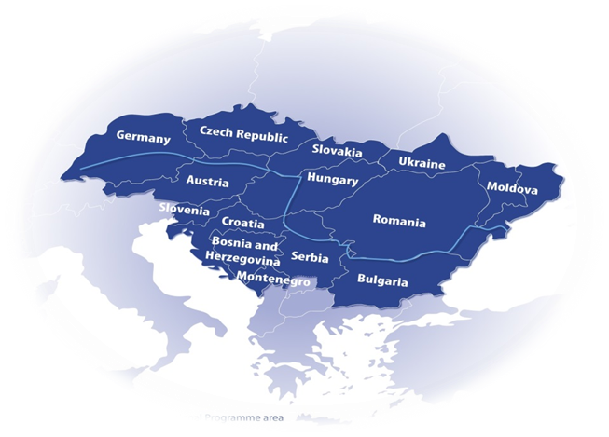
Programme area

Slide 3
Transnational Cooperation
transnational dimension:
project topic, addressed challenge and contributing project activities have transnational, broader territorial and/or thematic character and relevance (not limited to a few, 3-4 countries)
transnational impact:
based on the planned activities and outputs the impact of the project can be considered relevant on transnational scale and not only on local level in different parts of the region
A collection of different local actions of PPs under one „umbrella”, or cross-border cooperation is not transnational

Slide 4
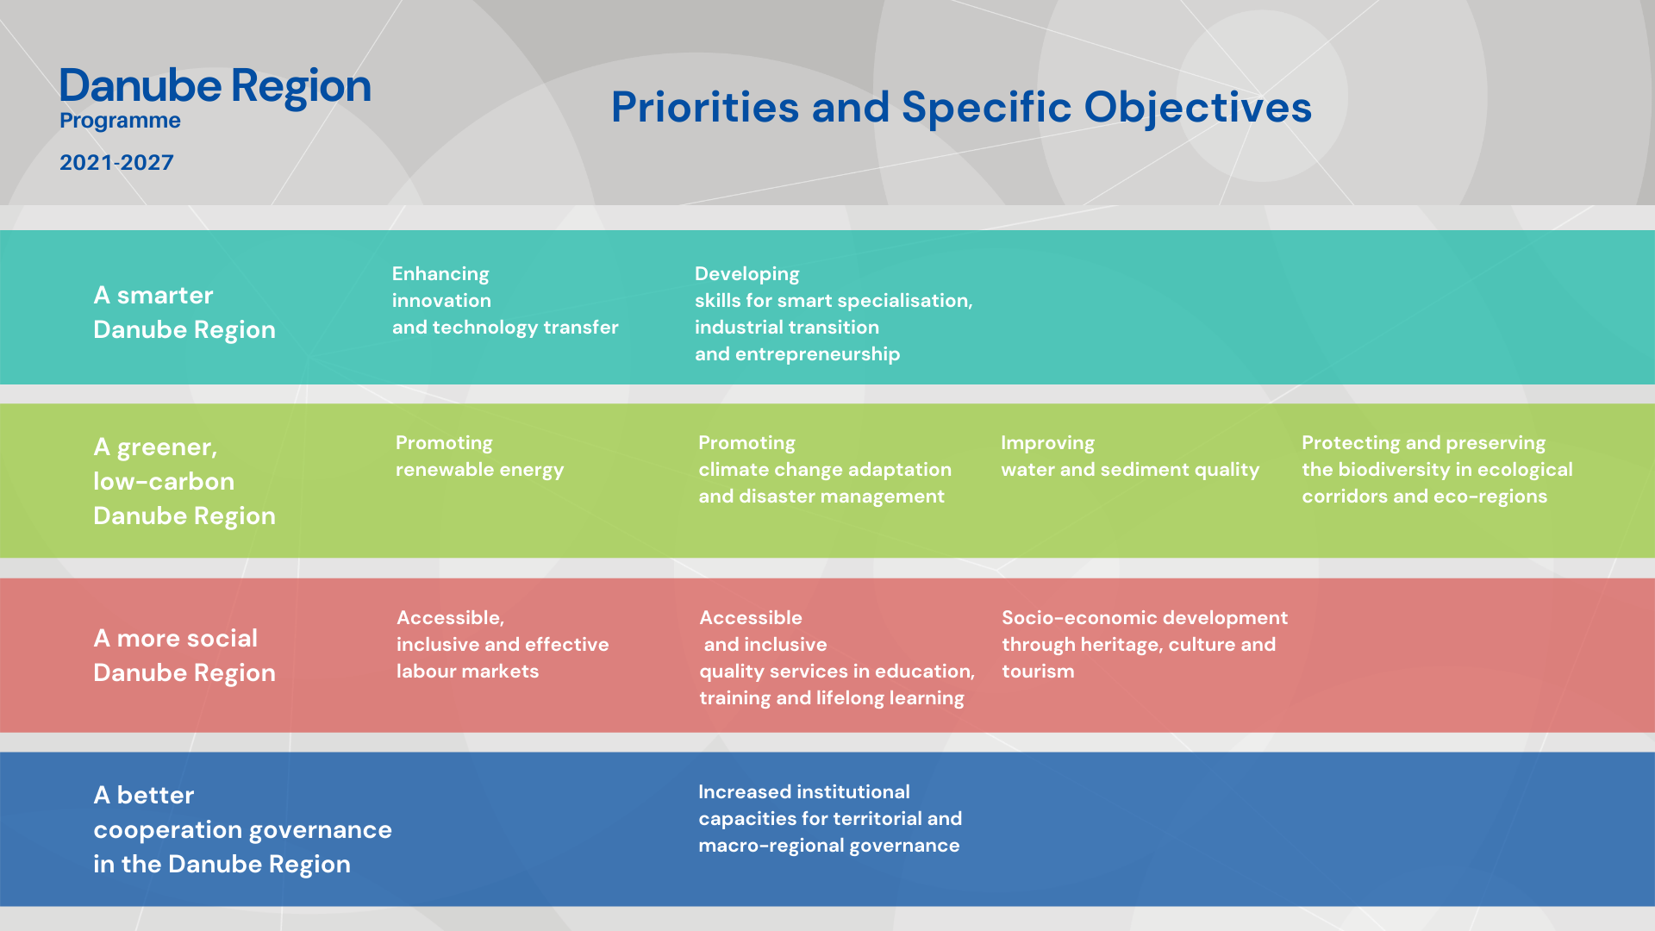

Slide 5
SO 2.4
Protecting and preserving the biodiversity in ecological corridors and ecoregions of transnational relevance in the Danube Region

Slide 6
SO 2.4 – needs and challenges
Danube Region - colourful mosaic of biogeographical regions & rich biodiversity
major rivers & mountain ranges - important transnational ecological corridors endangered by many factors:
  human interventions
  fragmentation of transnational habitats and ecosystems
  spreading of invasive alien species
  climate change impacting conditions of ecosystems
weak management capacities & skills for transnational ecological regions
impacts beyond country borders need for cooperation on a broader territorial level transnational cooperation

Slide 7
SO 2.4 - Focus
Territorial focus:
  broader, transnational ecological corridors
  transboundary ecological regions
  water habitats, wetlands along major transnational rivers
Thematic focus:
  improvement of ecological connectivity between habitats, nature protection areas along transnationally relevant ecological corridors
  transnational conservation and restoration measures for endangered umbrella species
  strengthening networks of cooperation in ecological regions & among protected areas
  ensuring resilience & adaptation to CC to reduce its impacts on biodiversity

Slide 8
SO 2.4 – What is supported
improve policies and institutional capacities (e.g. integrated strategies, action plans, policy & sectoral dialogs, trainings)
harmonising management processes (e.g. management plans)
elaborating, pilot testing joint solutions (e.g. data bases, monitoring tools, conservation / restoration methods)
reasonable mix of activities with clear thematic focus
territorially integrated, cross-sectoral approaches
taking into consideration potential negative effects of CC

Slide 9
SO 2.4 – What is supported
improve, manage, monitor ecological connectivity along transnationally relevant ecological corridors
  potentials of green and blue infrastructure developments and solutions for effective defragmentation
revitalisation & rehabilitation of water habitats along major transnational river (systems)
  potentials of restoration and reconnection of floodplains, wetlands
establishing management and cooperation networks of transboundary ecological regions & protected areas
resilience of habitats and ecosystems of transboundary ecological regions and their ability to adapt to climate change impacts
  eco-friendly land use systems, landscape management, soil protection and restoration measures
solutions in prevention and control of IAS and management of their priority pathways
monitoring, conservation, restoration and management plans for endangered umbrella species

Slide 10
SO 2.4 – What is not supported
if need for cooperation on transnational level not demonstrated
not focusing on transnationally relevant geographic area (ecological corridor, transboundary ecological region)
pre-dominant focus on infrastructure
pre-dominant focus on technical solution development without application by target users
pre-dominant focus on research /data collection without translating into applied solutions / policy strategies, plans
potentials of floodplain restoration in case focusing on flood protection (addressed in SO2.2), or focusing on water quality issues (addressed in SO2.3)

Slide 11
SO 2.4 – state of play after 1st call
1 project selected
ForestConnect - climate-smart forest connectivity for large carnivores in the Balkan-Carpathian Region
New proposals to focus on topics not addressed by the project!

Slide 12
SO 2.4 – typical mistakes in 1st call applications
missing appropriate geographic focus (transnationally relevant ecological region(s), or corridor(s))
limited partnership and / or territorial scope
unclear added value compared to previous similar project(s)
technology development in focus instead of specific territorial need
weaknesses in project intervention logic
missing links to relevant EUSDR PAs

Slide 13
Partnership
minimum requirement: 3 financing partners from 3 DRP countries
Competitive projects to be based on much broader partnerships!!!
  number of countries to be involved ensuring broad territorial impact in DR
  number of PPs ensuring thematic and territorial relevance and competence in a coherent mix and balanced way
integration of non-EU countries!!!
„INTERREG funds” = equal participation of EU and non-EU partners
  no differentiation of PPs by ERDF, IPA and NDICI funds
  Lead partner can be from any DRP country (in 2nd call not from UA)

Slide 14
Budget
„Interreg funds” – bringing together ERDF, IPA and NDICI funds
maximum EU (Interreg) contribution - 80%
2nd call allocation:
Priority 2 | Interreg funds per Priority in EUR | Indicative allocation per SO in EUR
SO 2.1 | closed
SO 2.2 | 15 339 422,00 | 5 960 525,00
SO 2.3 |  | 4 524 737,00
SO 2.4 |  | 4 854 160,00

Slide 15
DRP 2nd Call for Proposals
Call opening
  2 November 2023
  29 March 2024
Online application in DRP Jems (Joint Electronic Monitoring System – accessible on programme website)
Project duration: max. 36 months
Estimated project start: early 2025

Slide 16
Resources & tools
DRP INTERREG Programme - website
    How to apply (https://www.interreg-danube.eu/dtp-archive/about-dtp/new-funding-2021-2027/how-to-apply)
    2nd call (https://www.interreg-danube.eu/dtp-archive/about-dtp/new-funding-2021-2027/how-to-apply/second-call)
      Lead applicant and thematic webinars
      Applicants Package
DRP matchmaking platform for partner search (available soon)
Network of National Contact Points
JS: ad-hoc advice on technical/formal issues & one bilateral consultation
EUSDR PAs

Slide 17
Contact
Gusztáv Csomor – Senior Project Officer
gusztav.csomor@interreg-danube.eu
https://www.interreg-danube.eu/about-dtp/new-funding-2021-2027

