Slide 1


Slide 2
Transnational Cooperation
is an instrument of the EU Cohesion policy
financially supports cooperation projects beyond national level
in a geographically defined area in order to address common needs and challenges
it is meant to complement the mainstream programmes
brings together policy makers, academia, research, civil society and private actors

Slide 3
Danube Region
is a region of barriers, due to its highly fragmented status in political, economic and administrative aspects
has the highest number of countries (14) and highest number of borders compared to other macro-regions, (rate of border areas is 44.7%)
the European measures for a stronger cohesion along with the accession and neighbourhood policies create a new, unique historic situation for the better integration of the Danube space
Creating a better instiutional platform and transnational cooperation environment for the territorial, economic and social integration is the mission of the Danube Region to become region of flows

Slide 4
Sustainable economic development
large competitiveness gaps between the old, the new Member States and the non-EU countries, including their status within the regional innovation ecosystem.
a low share of technology and knowledge-intensive activities
need for strengthening synergies and cross-relationships between quadruple innovation stakeholders in order to facilitate the uptake of innovative technologies across the region

Slide 5
Sustainable economic development
Danube Region is still characterised by large cohesion gaps in social and economic aspects
solutions can be delivered through digitalisation, industry 4.0 processes and/or smart specialisation strategies and policies (S3) with a special focus on SMEs
large differences in S3 in terms of specialisation, sectors and territorial coverage.
support for transnational alignment of S3 strategies is of great importance

Slide 6
Funding opportunities - innovation
SO 1.1 Enhancing innovation and technology transfer in Danube region
SO 1.2 Development of skills for advancing smart specialisation strategies, industrial transformation and transition towards industry 4.0, including cross-sectorial collaborations

Slide 7
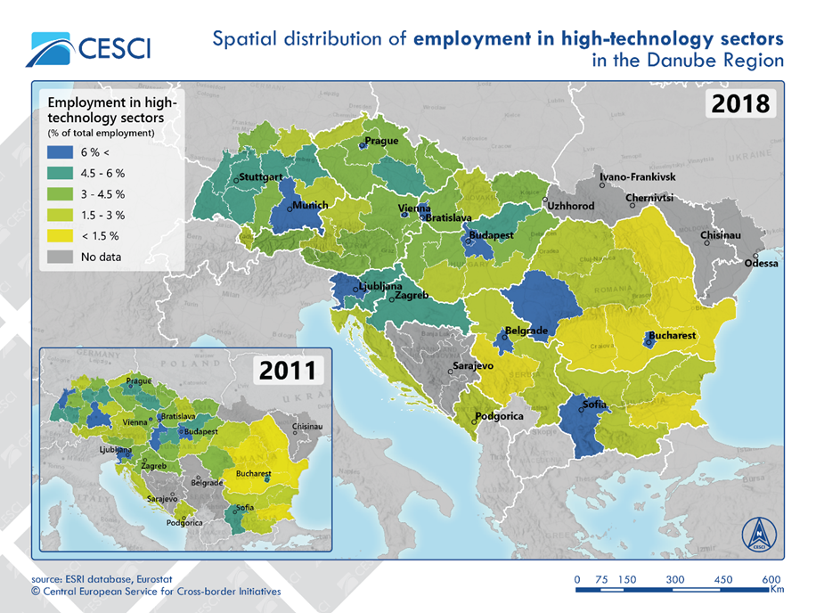
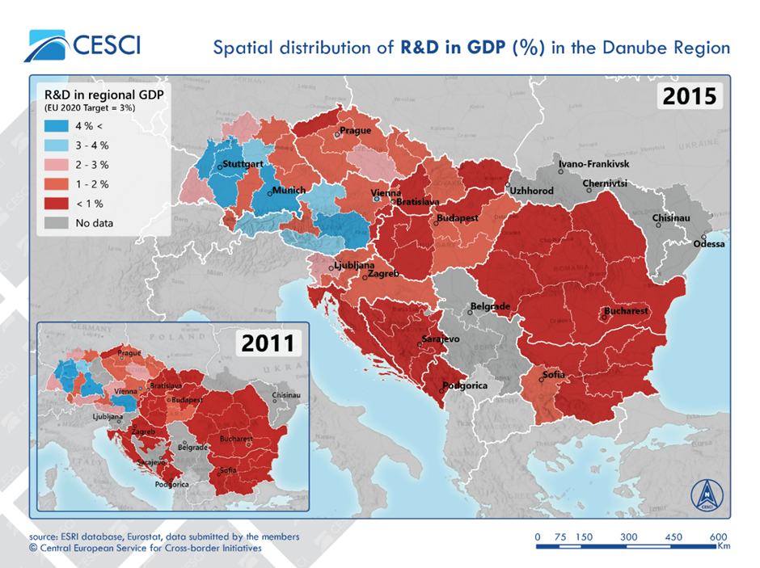
SO 1.1 - Needs and challenges

Slide 8
SO 1.1 - Needs and challenges
Across Danube Region, there is a low share of technology and knowledge-intensive activities. The RDI activities are overly concentrated within the western regions or the major urban hubs, including capital cities or university towns.
Structural problems arise, especially in regard to the development of hi-technology economic sectors or the low level of ICT employment.
Joint measures are of high relevance to support the better share of innovation capacities and the joint uptake of innovation and advanced technologies. Such actions should result from new, RDI related policies and furthered through quadruple helix approaches.

Slide 9
SO 1.1 - FOCUS
RDI related transnational policies and processes
uptake of innovation and advanced technologies
capacity building among thematic value chains
technology transfer and uptake from and towards SMEs
circular economy policies and processes
smart, sustainable and green transport technologies and networks
e-mobility solutions
integration of smart cities’ and regions’ solutions

Slide 10
SO 1.1 – Type of ACTIVITIES
Uptake of technologies alongside thematic value chains
Circular economy collaboration forms and harmonisation
Technology generation
Uptake of related advanced technologies
Direct contributions to EUSDR Action Plan for PA7 and PA8

Slide 11
SO 1.1 – What we do not finance
projects not being clearly embedded in a territorial scenario.
projects not involving countries of different level of innovation capacities.
projects with pre-dominant focus on infrastructure.
projects with pre-dominant focus on mere technical solution development without ensuring its application by the target users.
projects with pre-dominant focus on research and data collection activities without translating their outcomes into applied solutions and, or policy strategies, plans still within the project.
projects missing a clear focus and potential on closing the innovation gap in the Danube Region.

Slide 12
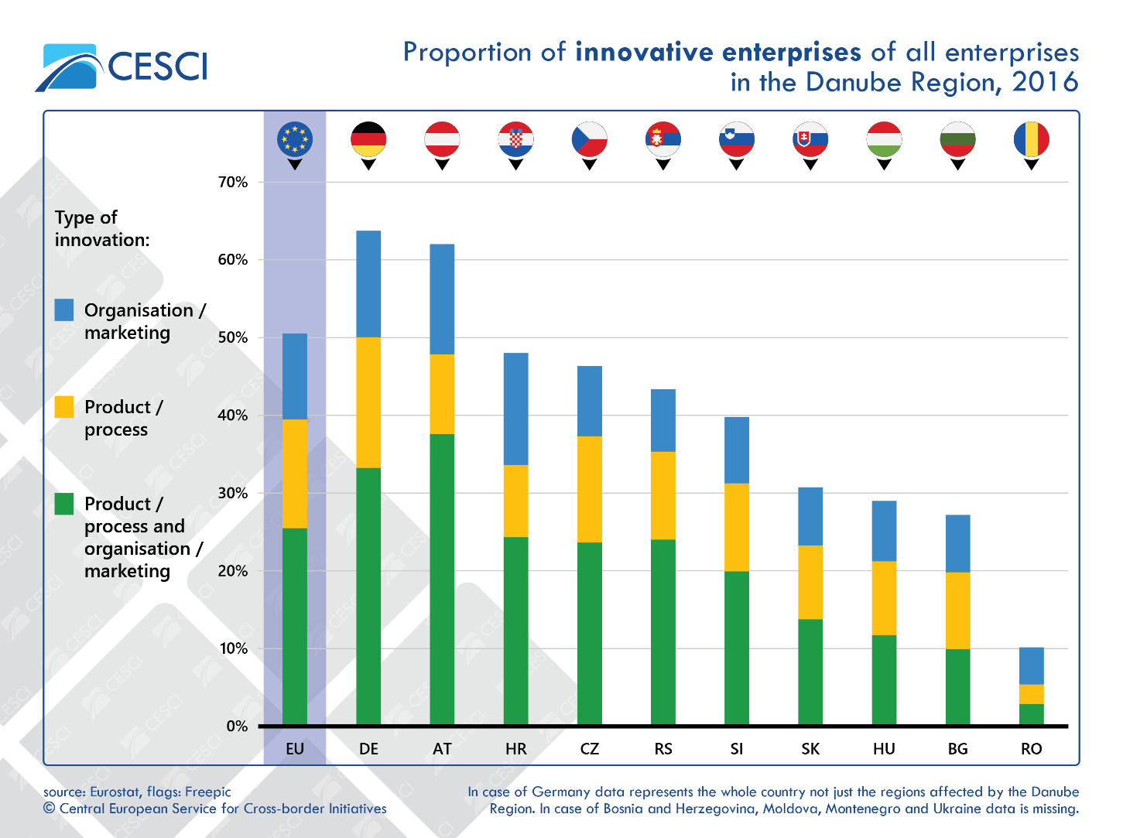
SO 1.2 Needs and challenges

Slide 13
SO 1.2 - Needs and challenges
the spatial pattern is quite fragmented, especially due to growing gaps between urban regions as engines of growth and rural regions as peripheries.
whilst some regional economies of the Danube Region are heavily industrialised
most economies seem too be unprepared for the challenges arising from transitioning to industry 4.0.
considering the overall entrepreneurial sector and, in particular, the SMEs, the innovation levels are substandard which results in a share of innovative enterprises below the EU average.

Slide 14
SO 1.2 - FOCUS
Skills development for and of joint advancement of smart specialisation strategies and policies – less advanced regions
Skills development and cross sectoral collaborations of smart and traditional type of industries – industrial transformation and transition
Skills development for delivering products and services with transnational impact

Slide 15
SO 1.2 – Type of ACTIVITIES
enhancing cooperation related to entrepreneurial skills in advanced technologies, industries of high DR importance – to better combine existing capacities and competences
building cooperation structures
obtaining innovation capacity needed
targeting competitiveness at regional and EU level
identifying niches within the EU market
becoming attractive as a partner within DR or towards other EU regions
establishing platforms for transfer knowledge and skills and
building interregional synergies for the development of regional smart specialisation strategies and policies by involving entrepreneurial actors and existing networks in discovering and exploiting promising areas of specialisation
setting up and piloting measures for regions – exchange of experience on implementation of S3

Slide 16
SO 1.2 – What we do not finance
projects not being clearly embedded in a territorial scenario.
projects not involving countries of different level of innovation capacities.
projects with pre-dominant focus on infrastructure.
projects with pre-dominant focus on research and data collection activities without translating their outcomes into applied solutions and/or policy strategies, plans still within the project.
projects missing a coordinated policy, planning and pilot tested led delivery approach.
projects targeting mere skills developments without having a strategic and policy level approach and impact.

Slide 17
Partnership
min. 3 partners are needed
integration of non-EU countries is of utmost importance
„INTERREG funds” – bringing together ERDF, IPA and NDICI funds will facilitate equal participation of non-EU partners
opening Lead Partnership status for all partners

Slide 18
D-Care Labs’ PPs – a good example of partnership
support organisations in the field of home care service provision without experiences in the field of social innovation labs – 5 PPs
support organisations in the field of home care with experiences in the area of social innovation labs – 2 PPs
professional lab providers with expertise in the field social investment – 3 PPs
expert partners – 2 PPs
scientific partners – 2 PPs

Slide 19
D-Care Labs’ ASPs – a good example of partnership
local level is responsible for the provision and delegation of social services
regional level is relevant for regional development, innovation structures and acts in some cases also as legislator
national level is especially relevant for legislation:
transnational private social investor complements the ASP partnership

Slide 20
Programme Budget
EUR 213,105,953.00
„INTERREG funds” – bringing together ERDF, IPA and NDICI funds
maximum EU contribution is 80% in 2021-2027 programming period
50% of the budget will be available in the 1st Call for Proposals
allocated total budget for Priority Area 1: EUR 37 490 510,25

Slide 21
Follow developments
DTP website:
  general information,
  Danube Programme document
  Call for Proposals announcement,
DRP events (e.g thematic webinars, Lead Applicants’ Seminar)
DTP National Contact Points
National events (e.g. national info days)
DRP Project Officer (e.g. bilateral consultations)
EUSDR PAs

Slide 22

Contact
Ms Katalin Kovács-Kasza
katalin.kovacs-kasza@interreg-danube.eu
https://www.interreg-danube.eu/about-dtp/new-funding-2021-2027

